Slide 1


Mikheil Kvizhinadze
December 12 2023

Slide 2

Outline
Executive Summary
Introduction
Methodology
Results
Conclusion
Appendix

Slide 3
Executive Summary
Summary of methodologies
Collection of data using web scraping to obtain information about SpaceX past rocket launches
Data wrangling and cleaning
Performing exploratory data analysis (EDA) using SQL and visualization tools
Interactive visual analytics with Folium and building dashboard with Plotly
Summary of all results
Providing correlation between various rocket parameters and success rate for launch
Use of machine learning to predict if next launch will be successful, based on previous data

Slide 4
Introduction
Optimizing SpaceX Falcon 9 Launch Success and Cost
This project tackles the crucial challenge of predicting the success of SpaceX's Falcon 9 first stage landings, a cornerstone of their cost-effective spaceflight revolution. With each Falcon 9 launch costing approximately $62 million compared to competitors' $165 million, successful first stage landings are critical for maximizing cost-effectiveness and maintaining a competitive edge.
Beyond predicting landing success, this project also aims to accurately determine the cost of each launch and predict the likelihood of SpaceX reusing the first stage. These insights will provide valuable information for optimizing future launch strategies and further enhancing SpaceX's dominance in the space industry.
Through the meticulous collection of relevant data and the implementation of a robust machine learning pipeline, this project will empower SpaceX to make informed decisions, maximize efficiency, and solidify its position as a leader in the new space race.

Slide 5

Section 1

Slide 6
Methodology
Executive Summary
Data collection methodology using Web Scraping and parsing HTML documents using BeautifulSoup
Perform data wrangling using Pandas and Numpy
Perform exploratory data analysis (EDA) using visualization and SQL
Perform interactive visual analytics using Folium and Plotly Dash
Perform predictive analysis using classification modelsS

Slide 7
Data Collection
Data Acquisition for SpaceX Falcon 9 Analysis
This project leveraged two primary data sources to analyze SpaceX Falcon 9 launches:
1. SpaceX API:
Employed a RESTful API interface to retrieve launch data.
Defined helper functions to facilitate extraction using launch identifier numbers.
Requested and parsed JSON response data using GET requests.
Decoded the response and converted it into a Pandas DataFrame for further analysis.
2. Web Scraping:
Scraped historical launch records from a dedicated Wikipedia page.
Utilized BeautifulSoup and Requests libraries for efficient data extraction.
Extracted the Falcon 9 launch data from an HTML table format.
Parsed the table and converted it into a Pandas DataFrame for integration with the API data.

Slide 8
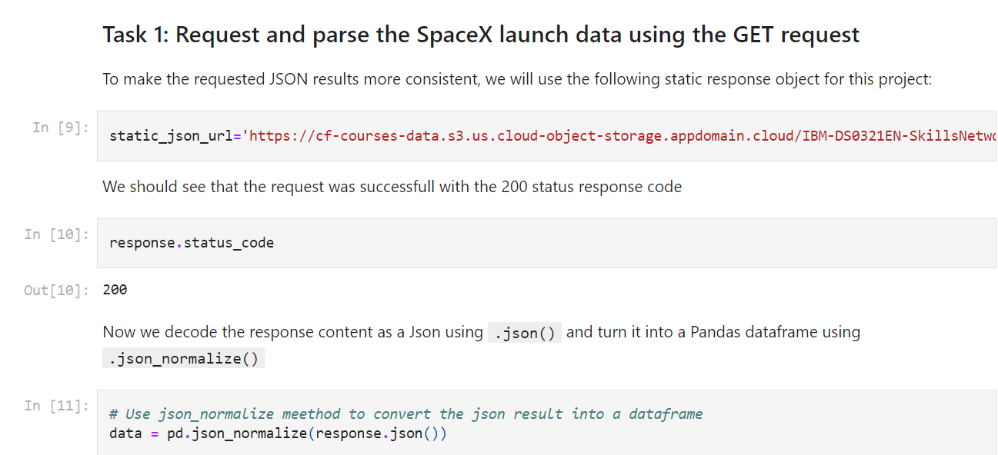
Data Collection – SpaceX API
GET request is used to request SpaceX launch data and then data filtering and wrangling is performed using Pandas
Part of notebook is provided here, Github link is provided below.
Link: https://github.com/MikheilKvizhinadze2001/Applied_Data_Science_Capstone_IBM/blob/main/jupyter-labs-spacex-data-collection-api.ipynb
Place your flowchart of SpaceX API calls here

Slide 9
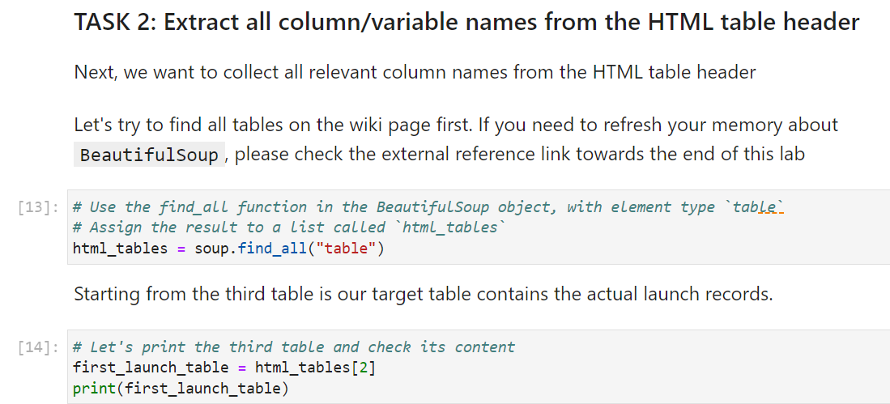
Data Collection - Scraping
Getting relevant HTML document and using BeautifulSoup to parse the data
Creating data frame using Pandas
Detailed explanation is provided below (Github link):
https://github.com/MikheilKvizhinadze2001/Applied_Data_Science_Capstone_IBM/blob/main/web_scraping.ipynb

Slide 10
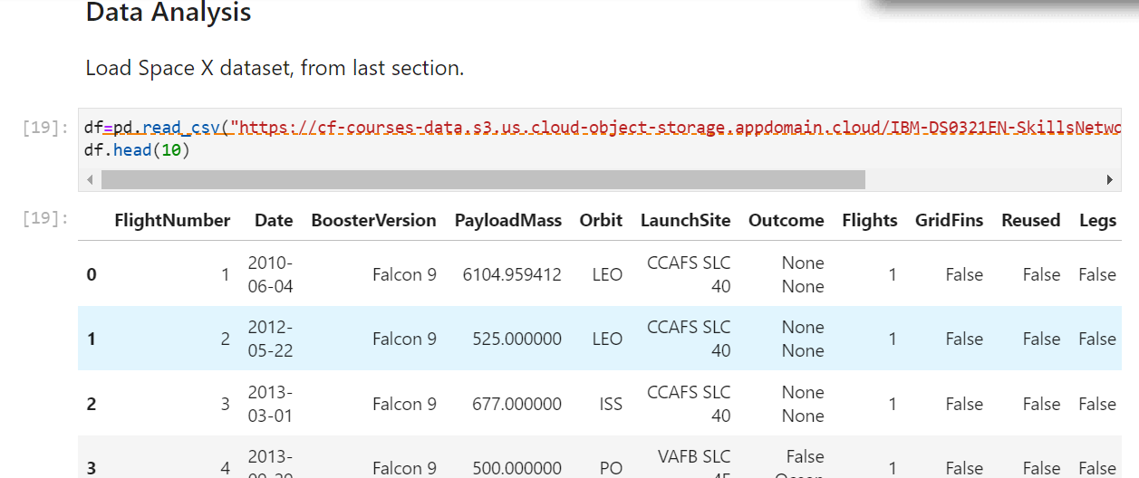
Data Wrangling
Data Wrangling Process for SpaceX Falcon 9 Landing Analysis
Data Acquisition:
Reading data from CSV file
Data Cleaning:
Identifying and handling missing values.
Addressing inconsistencies and formatting issues.

Slide 11
Data Wrangling (Continued)
Feature Engineering:
Encoding categorical features.
Deriving new features relevant to landing success.
Label Creation:
Converting existing "Landing_Outcome" values to binary labels:
1 - Successful landing (True Ocean, True RTLS, True ASDS)
0 - Unsuccessful landing (False Ocean, False RTLS, False ASDS)
Data Validation:
Checking for data integrity and consistency.
Ensuring correct label assignment.
Github Link for Jupyter notebook:
https://github.com/MikheilKvizhinadze2001/Applied_Data_Science_Capstone_IBM/blob/main/labs-jupyter-spacex-Data%20wrangling%20(1).ipynb

Slide 12
EDA with Data Visualization
Exploratory Data Analysis and Feature engineering is performed using visualization tools
Tool used: Pandas, Numpy, Seaborn, Matplotlib
Aims: Explore patterns and possible relationships between variables like Payload mass and Orbit or relationship between flight number and payload mass
Github link https://github.com/MikheilKvizhinadze2001/Applied_Data_Science_Capstone_IBM/blob/main/jupyter-labs-eda-dataviz.ipynb.jupyterlite.ipynb

Slide 13
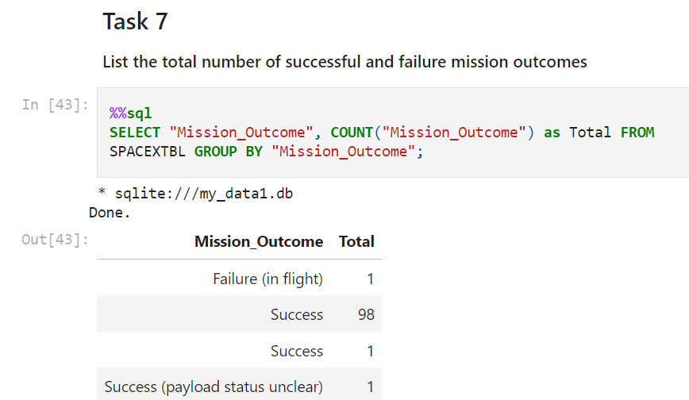
EDA with SQL
In addition to visualization tools, SQL was also used for exploratory data analysis
For example, we found out that SpaceX is extremely successful in mission outcomes
Github link for Jupyter notebook
https://github.com/MikheilKvizhinadze2001/Applied_Data_Science_Capstone_IBM/blob/main/jupyter-labs-eda-sql-coursera_sqllite%20(1).ipynb

Slide 14
Build an Interactive Map with Folium
Python library Folium is used for interactive web maps, to visually analyze the relationship between SpaceX launch site locations and launch success rates.
Map Objects Created:
Markers: These represent individual launch sites, visually indicating their geographical positions.
Circles: These depict the proximity areas around each launch site, providing insights into potential geographical factors influencing success rates.
Lines: These connect each launch site to its corresponding proximity circle, further clarifying the spatial relationships.:

Slide 15
Build an Interactive Map with Folium
Markers: Provide a clear and intuitive representation of individual launch sites, allowing users to readily identify their locations.
Lines: Connect each launch site to its corresponding proximity circle, strengthening the visual association between the two elements and facilitating interactive exploration of the data.
By leveraging these map objects, this analysis aims to discover geographical patterns and correlations between launch site locations and success rates, ultimately contributing to a deeper understanding of the factors affecting SpaceX launch outcomes.
Github link: Applied_Data_Science_Capstone_IBM/Folium_Visualization.ipynb at main · MikheilKvizhinadze2001/Applied_Data_Science_Capstone_IBM · GitHub

Slide 16
Build a Dashboard with Plotly Dash
This dashboard features several interactive visualizations to explore the relationships between launch site, payload, and mission outcome for SpaceX Falcon 9 missions.
Launch Site Selection:
A Launch Site Drop-down Input Component allows users to select a specific launch site.
A callback function dynamically renders a Success Pie Chart visualizing the launch success counts for the selected site. This helps identify launch success rates for individual sites and compare them across different locations.

Slide 17
Build a Dashboard with Plotly Dash
Payload Exploration:
A Range Slider allows users to select a specific range of payload values.
A callback function renders a Success-Payload Scatter Plot based on the selected payload range. This enables visual exploration of potential correlations between payload mass and mission success.
Color-coded Booster versions on the scatter plot provide insights into the performance of different booster configurations across various payload ranges.
Github link: https://github.com/MikheilKvizhinadze2001/Applied_Data_Science_Capstone_IBM/blob/main/spacex_dash_app.py

Slide 18
Predictive Analysis (Classification)
The following steps were taken to build, evaluate, improve, and find the best performing classification model:
The data was prepared by cleaning it, engineering new features, and standardizing it.
A set of classification models was selected and trained on the training data.
GridSearchCV was used to find the best hyperparameters for each model.
The accuracy of each model was calculated on the test data.
The model with the highest accuracy on the test data, the Support Vector Machine, was selected as the best performing model.

Slide 19
Predictive Analysis (Classification)
Steps:
Data Preparation:
Clean the data to remove any errors or inconsistencies.
Engineer new features that may be relevant to the prediction task.
Standardize the data to bring all features to the same scale.
Model Selection:
Choose a set of classification models to evaluate.
Train each model on the training data.
Evaluate the performance of each model on the test data.

Slide 20
Predictive Analysis (Classification)
3.Hyperparameter Tuning:
Use GridSearchCV to find the best hyperparameters for each model.
GridSearchCV will train the model with different combinations of hyperparameters and evaluate the performance of each combination on the training data.
The best hyperparameters are the ones that produce the highest accuracy on the training data.
4.Model Evaluation:
Calculate the accuracy of each model on the test data.
The model with the highest accuracy on the test data is the best performing model.

Slide 21

Section 2

Slide 22
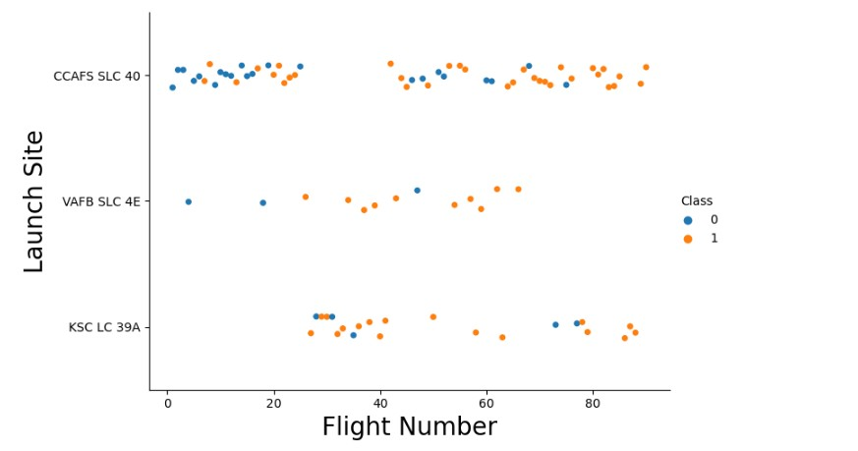
Flight Number vs. Launch Site

Slide 23
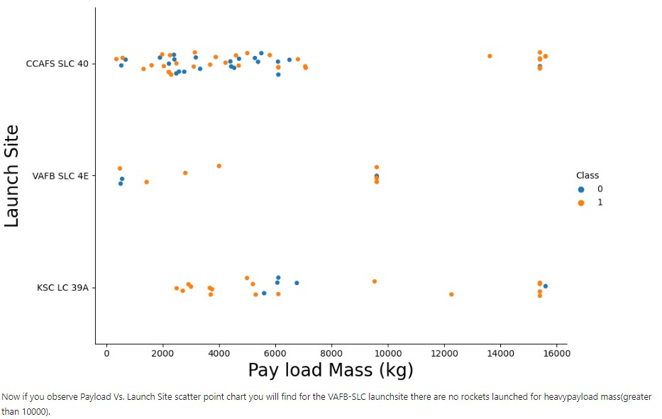
Payload vs. Launch Site

Slide 24
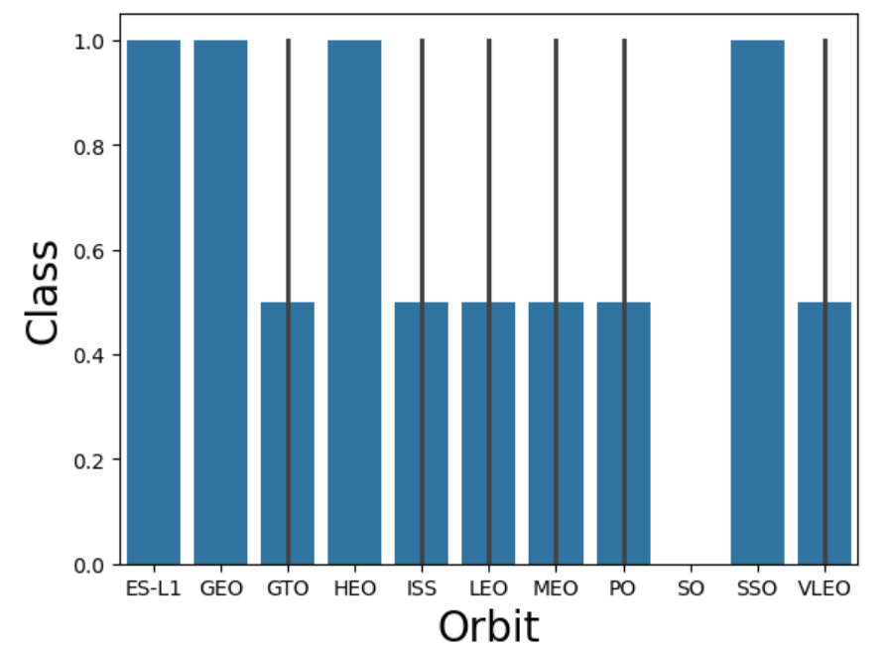
Success Rate vs. Orbit Type

Slide 25
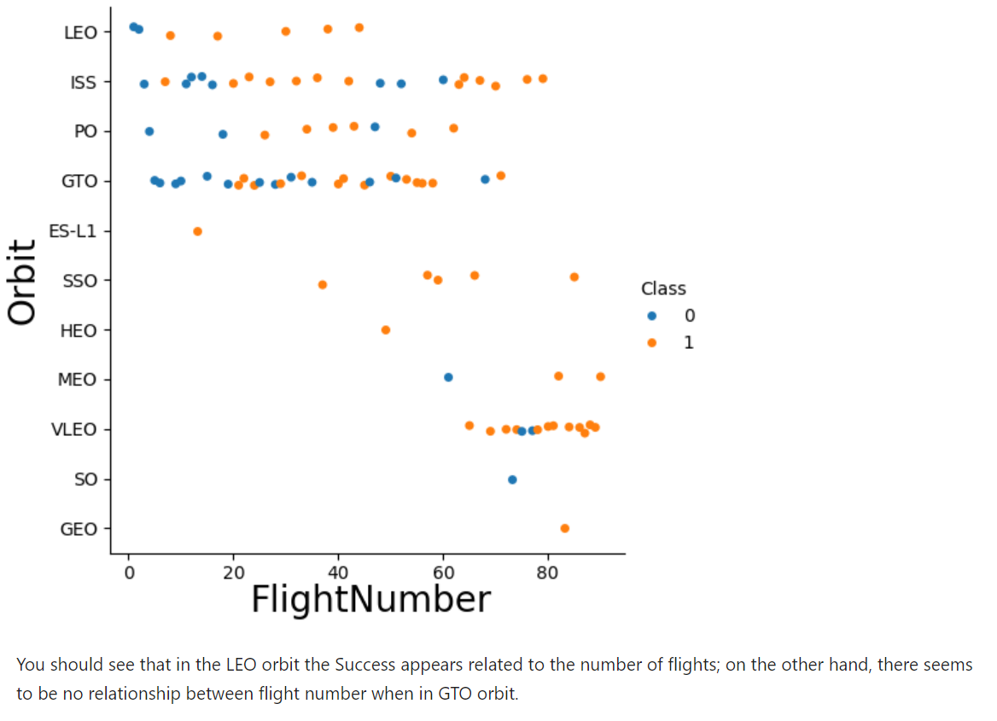
Flight Number vs. Orbit Type

Slide 26
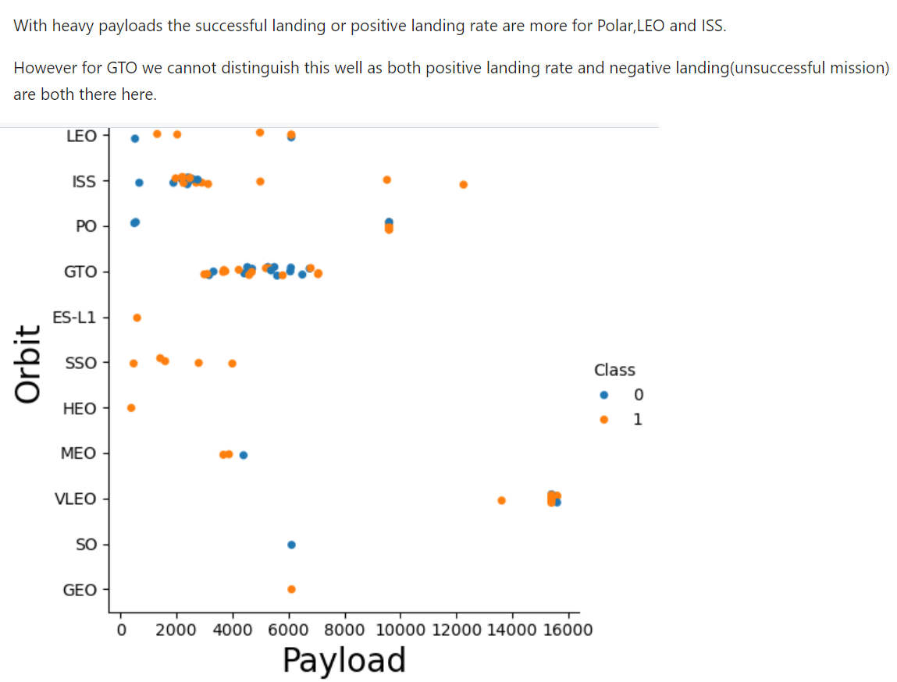
Payload vs. Orbit Type

Slide 27
Launch Success Yearly Trend
Show a line chart of yearly average success rate
Show the screenshot of the scatter plot with explanations

Slide 28
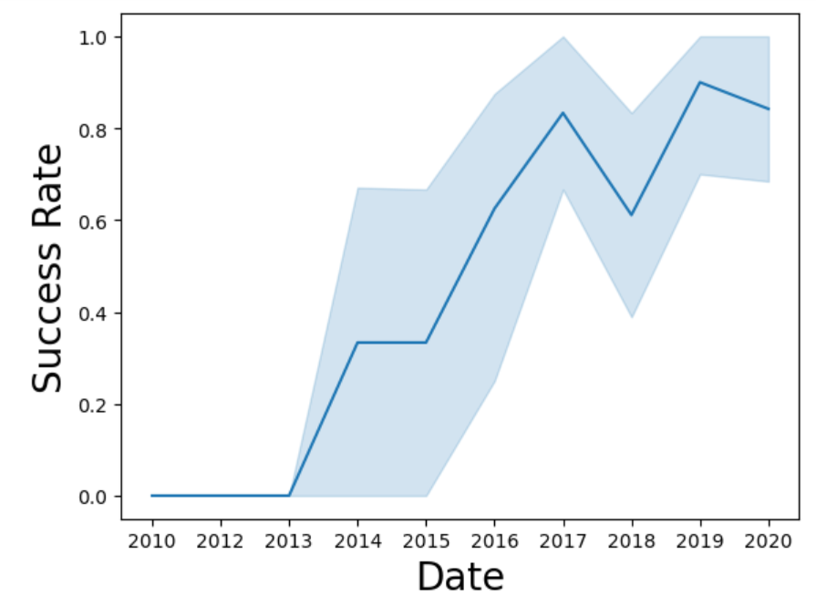
Launch Success Yearly Trend
This graph reveals an association between success rate and date. Combined with previous observations, it suggests an increasing trend in flight success predictability over time. This implies that SpaceX is continuously improving their technology and refining their launch processes, leading to a higher likelihood of successful missions as time progresses.

Slide 29
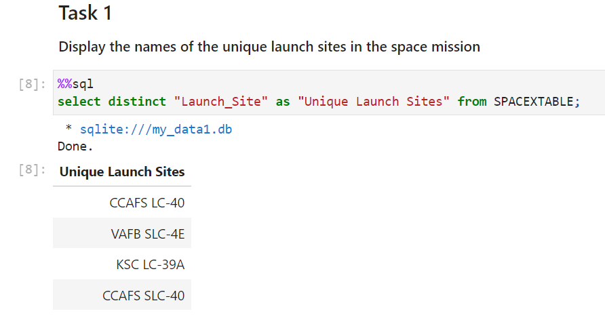
All Launch Site Names

Slide 30
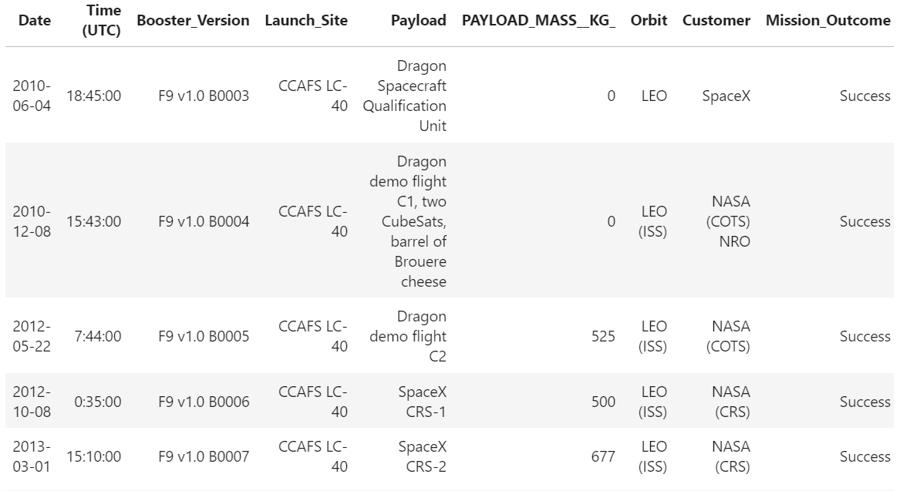
Launch Site Names Begin with 'CCA’ (Five of them)

Slide 31
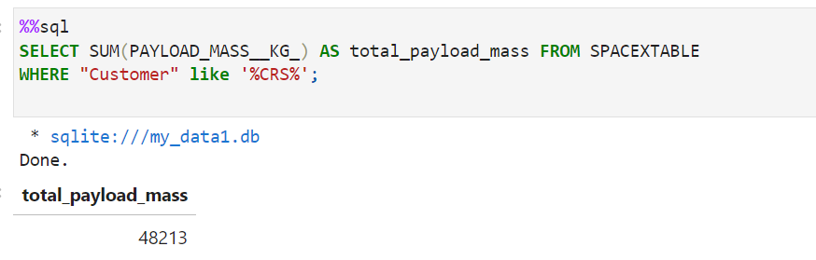
Total Payload Mass

Slide 32
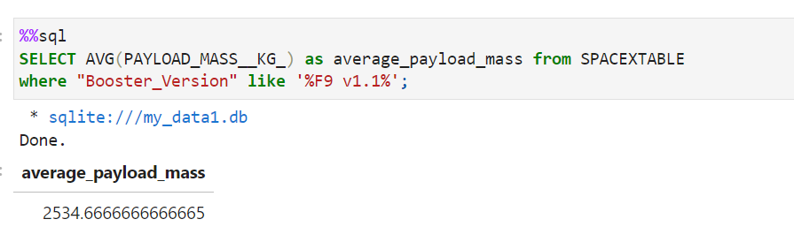
Average Payload Mass by F9 v1.1

Slide 33
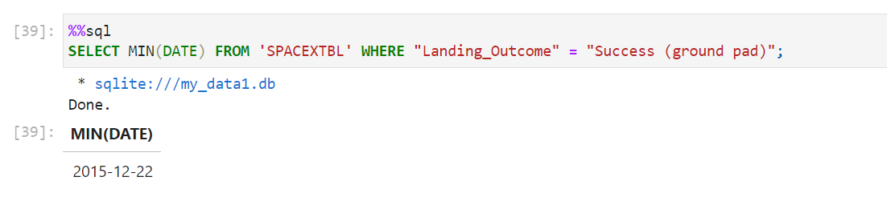
First Successful Ground Landing Date

Slide 34
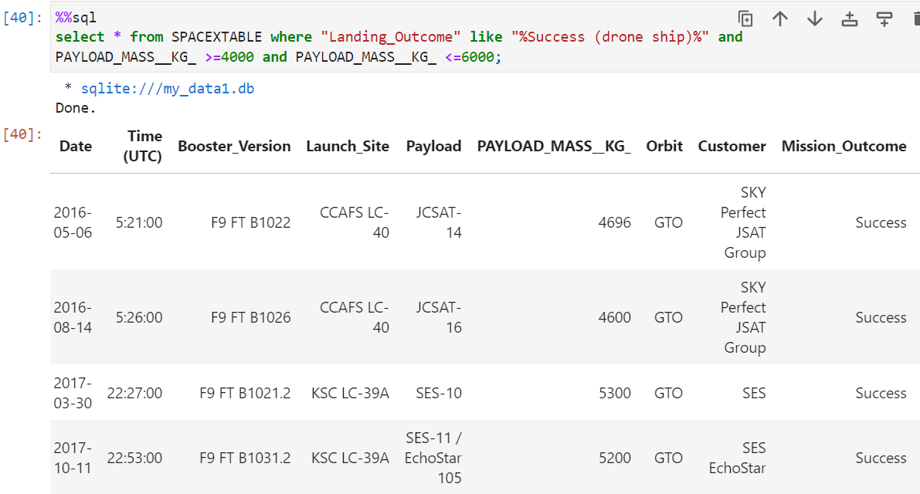
Successful Drone Ship Landing with Payload between 4000 and 6000

Slide 35
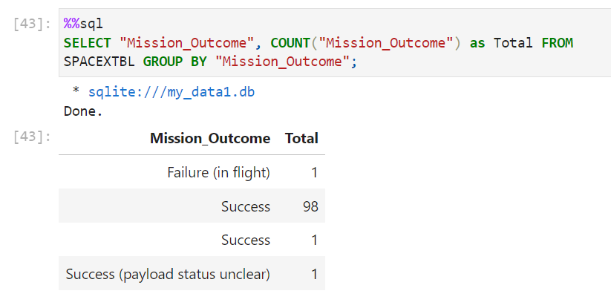
Total Number of Successful and Failure Mission Outcomes

Slide 36
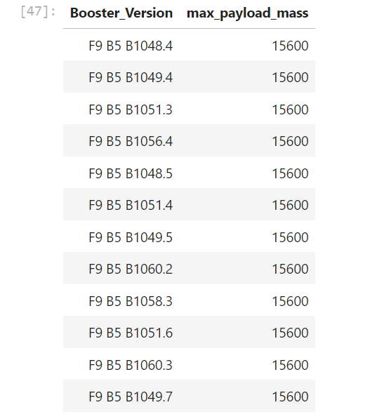
Boosters Carried Maximum Payload

Slide 37
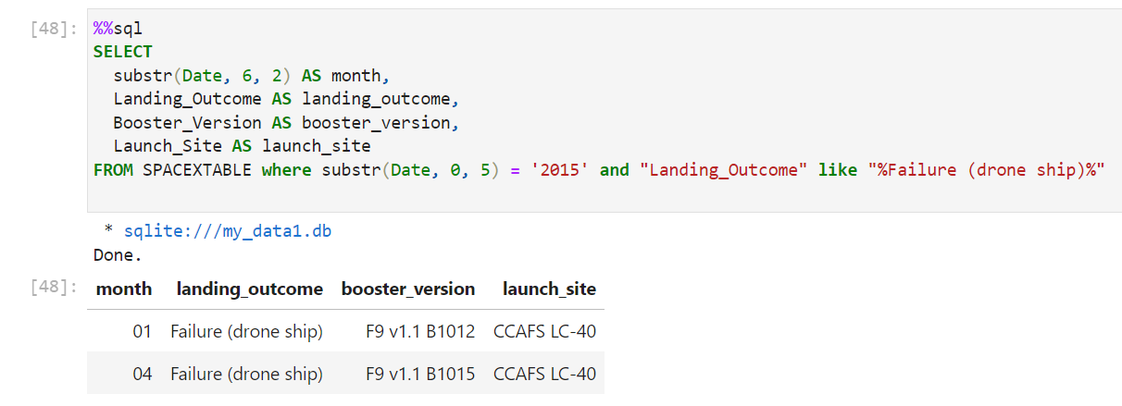
2015 Launch Records

Slide 38
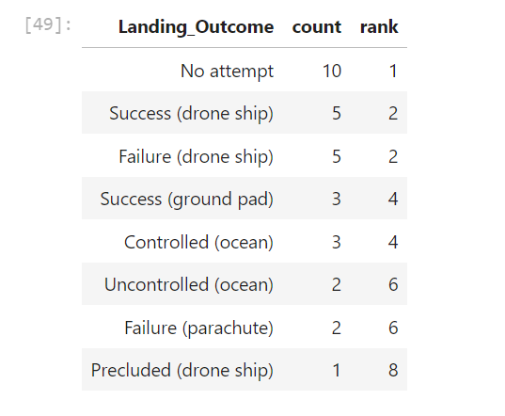
Rank Landing Outcomes Between 2010-06-04 and 2017-03-20

Slide 39

Section 3

Slide 40
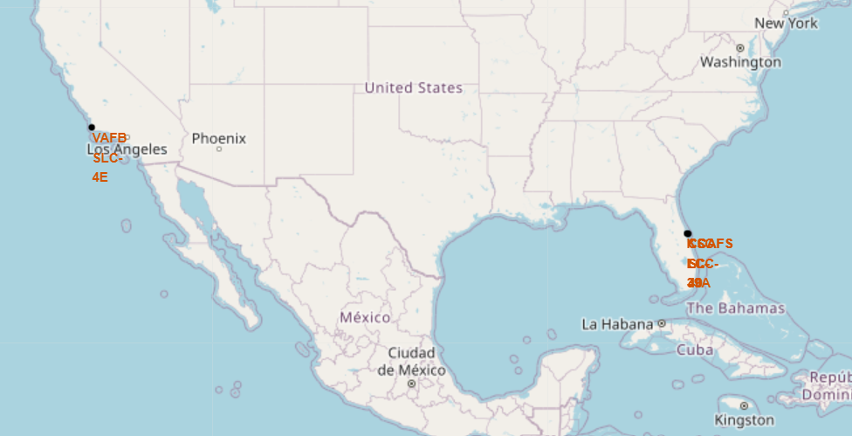
Launch Site Locations
We can see that all launch site locations are near coasts

Slide 41
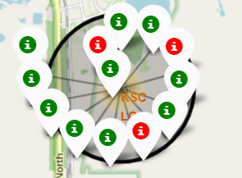
Kennedy Space Center Launch Complex 39A
Success rate is relatively high

Slide 42
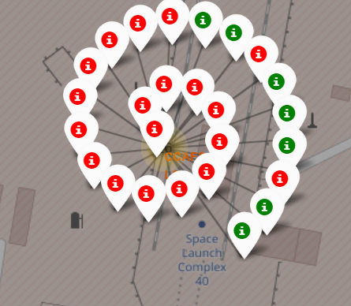
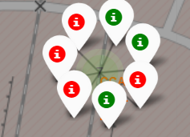
Cape Canaveral Space Launch Complex 40 Success rates

Slide 43
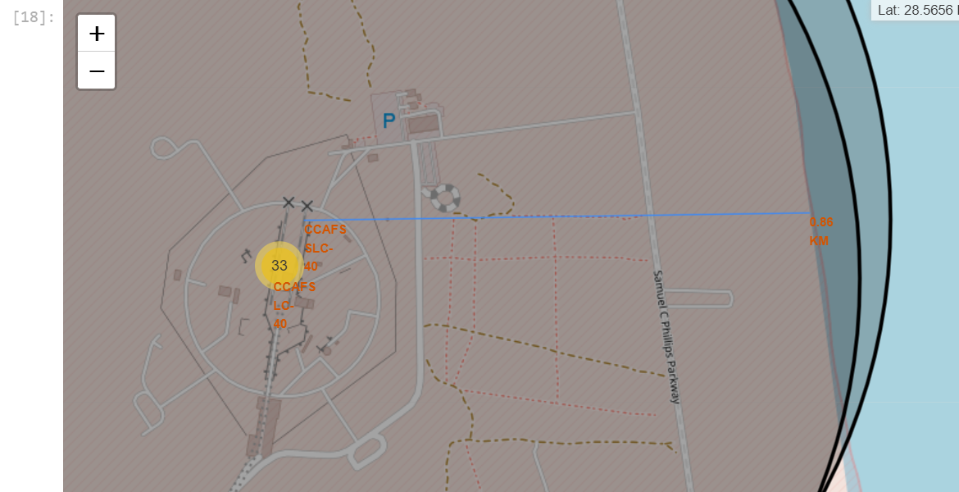
Cape Canaveral Space Launch Complex 40 Proximities

Slide 44

Section 4

Slide 45
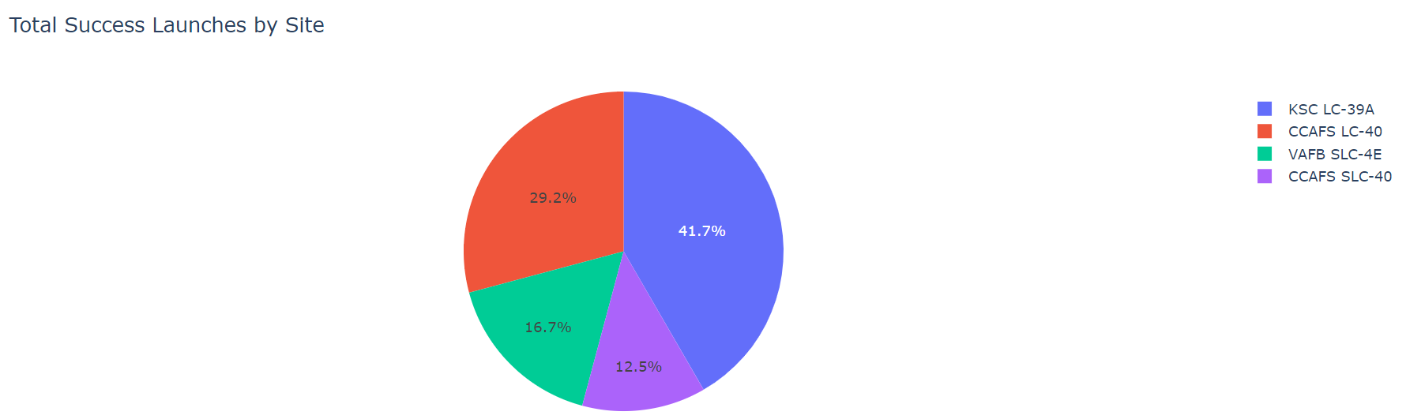
Success Launches by Site

Slide 46
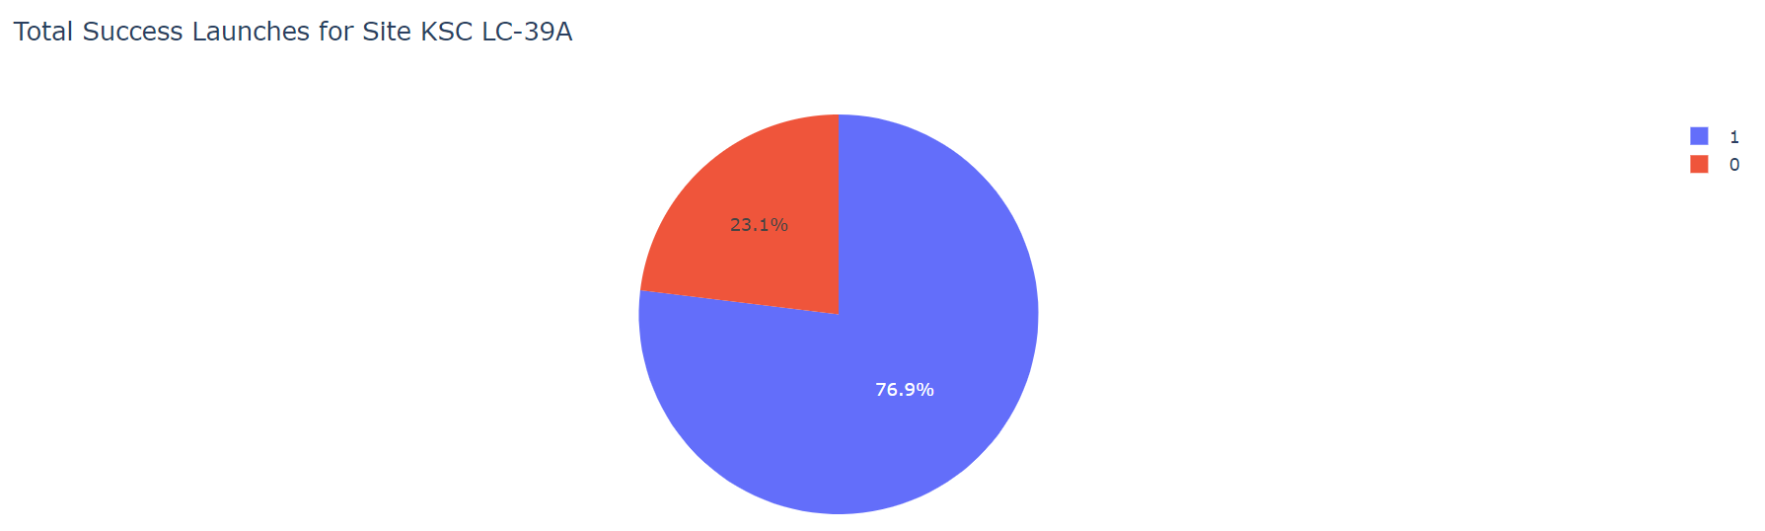
Highest Success Ratio - KSC LC-39A Site

Slide 47
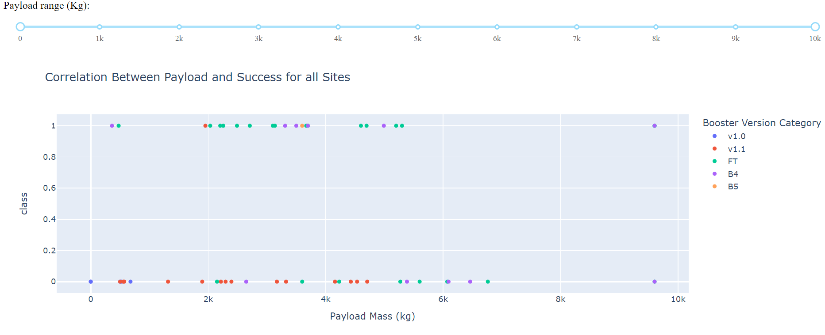
Relationship between Payload and Success

Slide 48

Section 5

Slide 49
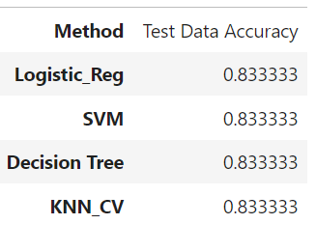
Classification Accuracy Comparison of Different Models

Slide 50
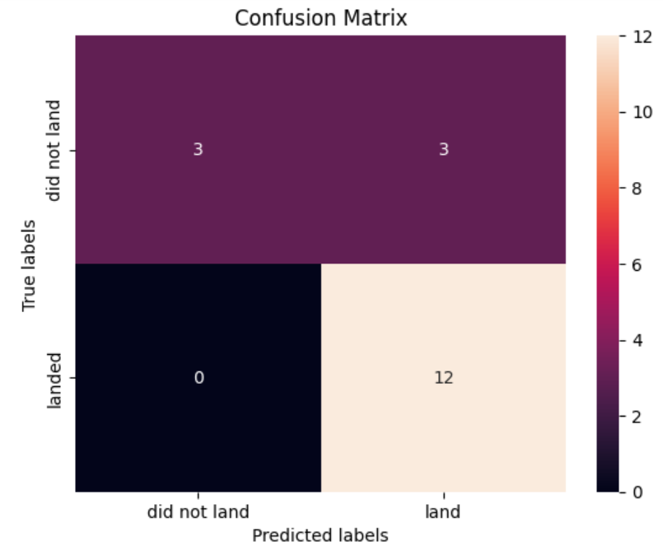
Confusion Matrix

Slide 51
Conclusions
To conclude, as the time goes and #flights increase, success rate steadily increasing, therefore we can conclude that positive expectations towards future launches are plausible.
Highest success rate has Kennedy Space Center Launch Complex 39A, with a rate of 76.9%
There is no direct correlation between payload mass and success rate
But, as #flights increase, payload mass also increases, meaning rockets are getting large and more massive

Slide 52


